Slide 1


BOOTH ALGORITHM
-Mahima Manni

Slide 2


History
The algorithm was invented by Andrew Donald Booth in 1950 while doing research on crystallography at Birkbeck College in Bloomsbury, London.
Booth's algorithm is of interest in the study of computer architecture.

Slide 3


What is Booth Algorithm?
Booth algorithm gives a procedure for multiplying binary integers in signed 2’s complement representation in efficient way, i.e., less number of additions/subtractions required. It operates on the fact that strings of 0’s in the multiplier require no addition but just shifting and a string of 1’s in the multiplier from bit weight 2^k to weight 2^m can be treated as 2^(k+1 ) to 2^m.
As in all multiplication schemes, booth algorithm requires examination of the multiplier bits and shifting of the partial product. Prior to the shifting, the multiplicand may be added to the partial product, subtracted from the partial product, or left unchanged according to following rules:
The multiplicand is subtracted from the partial product upon encountering the first least significant 1 in a string of 1’s in the multiplier
The multiplicand is added to the partial product upon encountering the first 0 (provided that there was a previous ‘1’) in a string of 0’s in the multiplier.
The partial product does not change when the multiplier bit is identical to the previous multiplier bit.

Slide 4
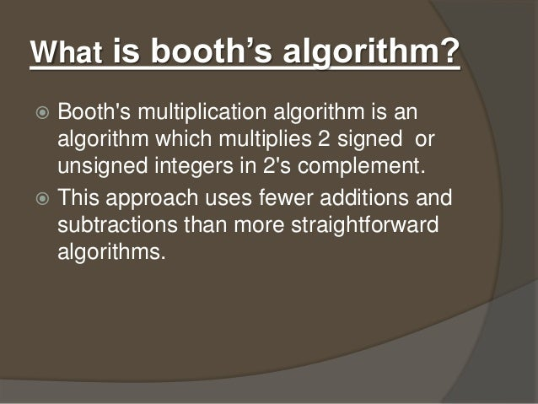

Slide 5
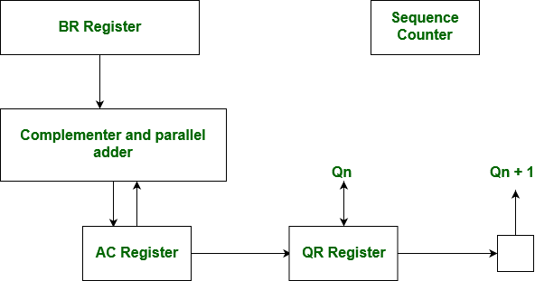
Hardware Implementation of Booths Algorithm
The hardware implementation of the booth algorithm requires the register configuration shown in the figure below.

Slide 6
Booth’s Algorithm Flowchart –
We name the register as A, B and Q, AC, BR and QR respectively. Qn designates the least significant bit of multiplier in the register QR. An extra flip-flop Qn+1is appended to QR to facilitate a double inspection of the multiplier. The flowchart for the booth algorithm is shown:

Slide 7
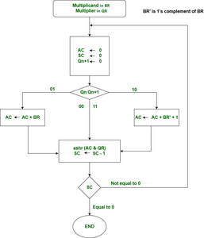
FlowChart of Booth Algorithm

Slide 8
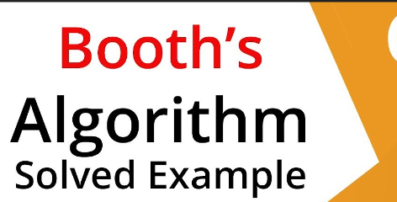
Example
A numerical example of booth’s algorithm is shown below for n = 4. It shows the step by step multiplication of -5 and -7.
BR = -5 = 1011, BR' = 0100, <-- 1's Complement (change the values 0 to 1 and 1 to 0) BR'+1 = 0101 <-- 2's Complement (add 1 to the Binary value obtained after 1's complement) QR = -7 = 1001 <-- 2's Complement of 0111 (7 = 0111 in Binary) The explanation of first step is as follows: Qn+1 AC = 0000, QR = 1001, Qn+1 = 0, SC = 4 Qn Qn+1 = 10 So, we do AC + (BR)'+1, which gives AC = 0101 On right shifting AC and QR, we get AC = 0010, QR = 1100 and Qn+1 = 1

Slide 9
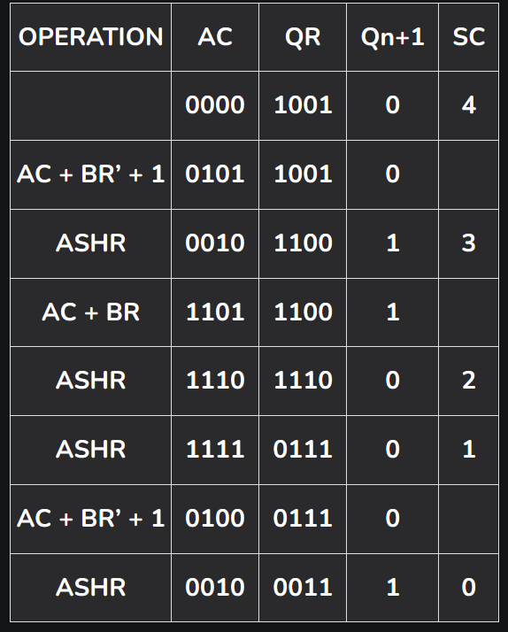
Product is calculated as follows:
Product = AC QR Product = 0010 0011 = 35

Slide 10

Looking forward to the example

Slide 11
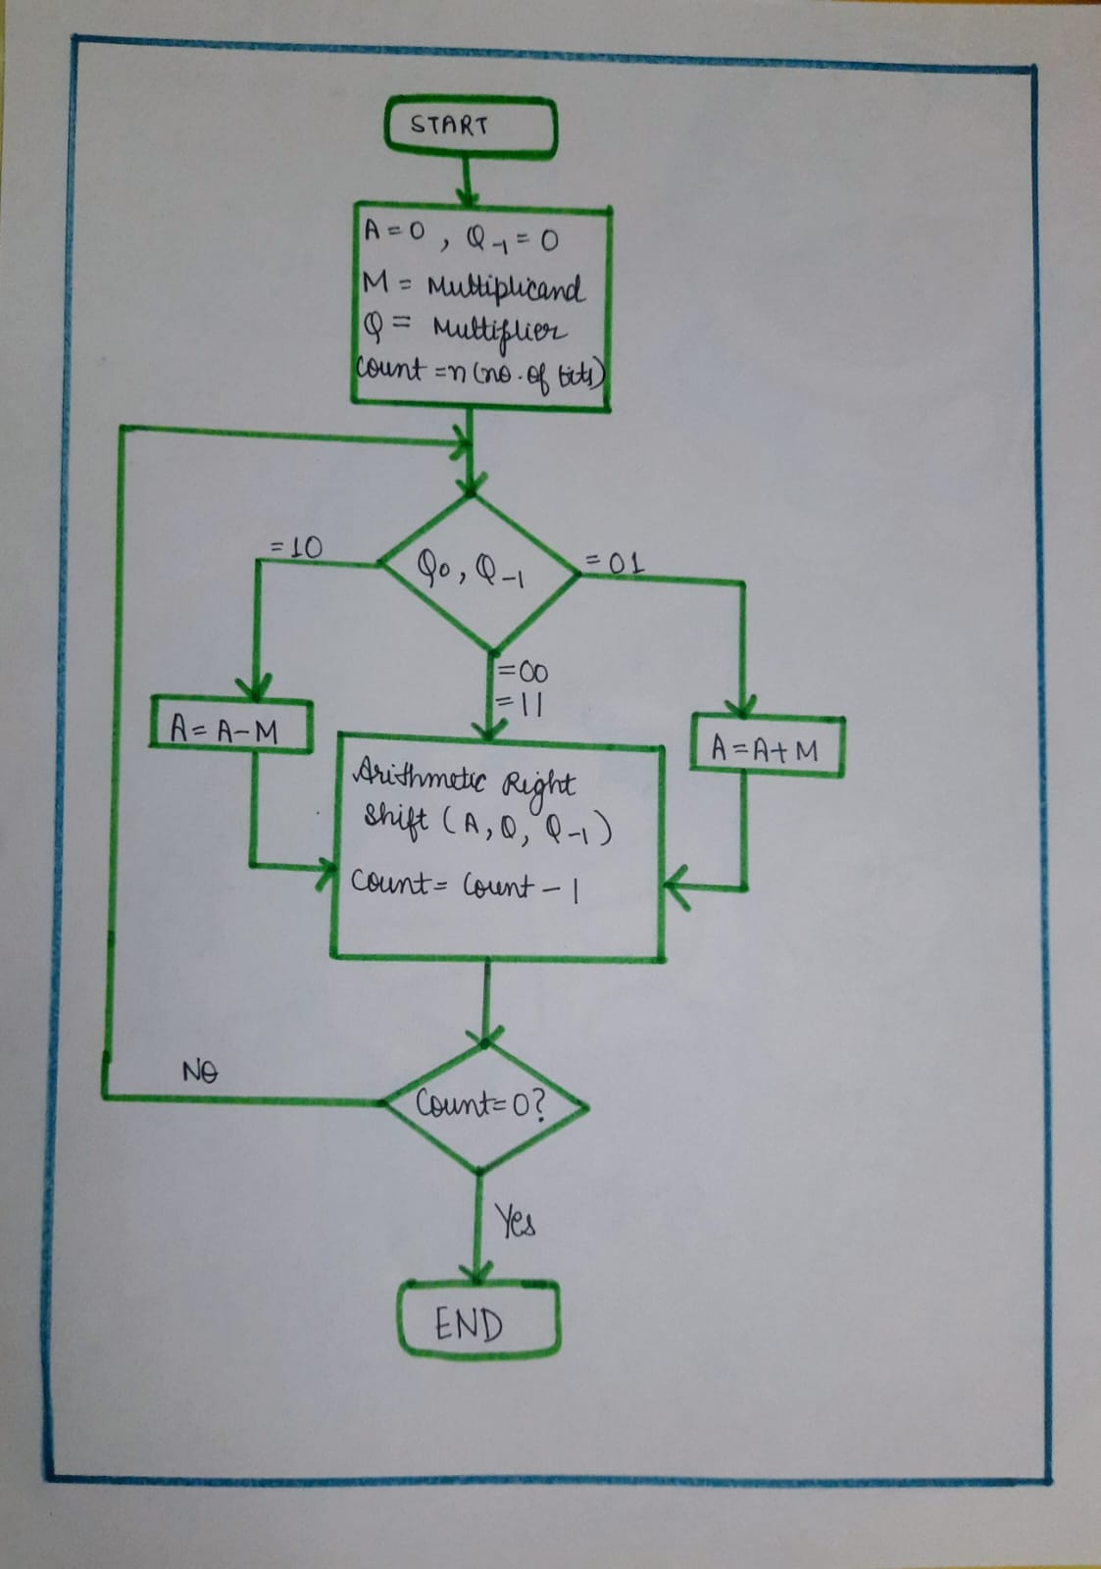
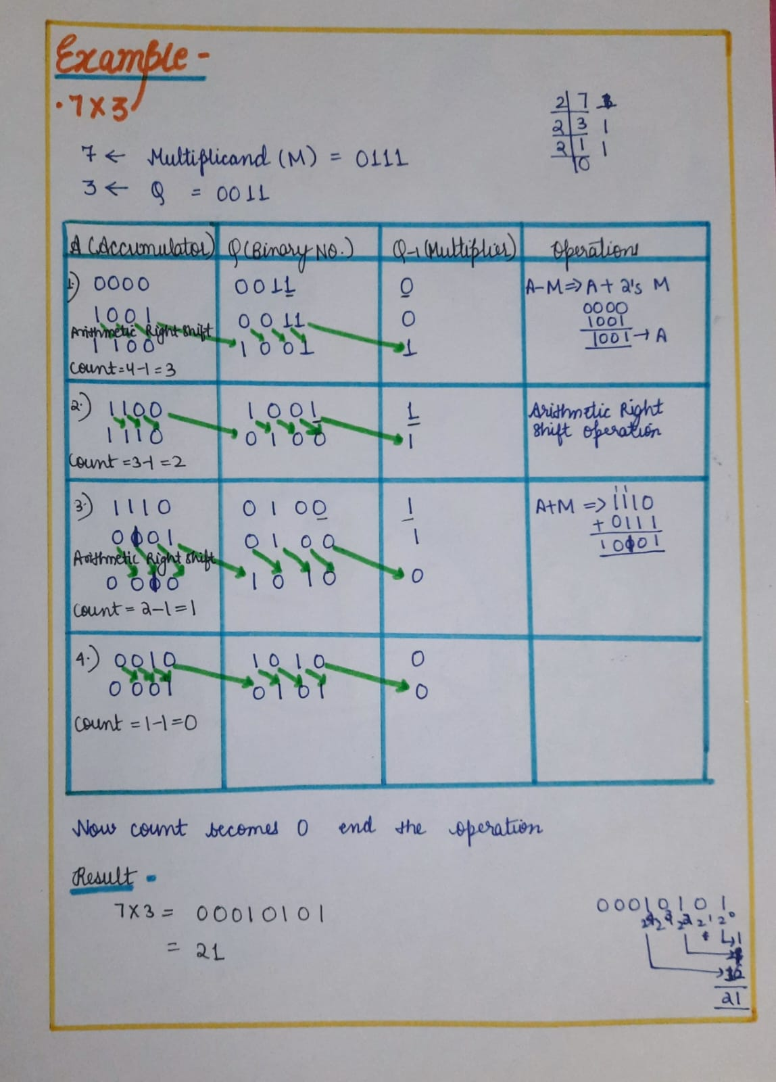

Slide 12
Advantages:
Faster than traditional multiplication: Booth’s algorithm is faster than traditional multiplication methods, requiring fewer steps to produce the same result.
Efficient for signed numbers: The algorithm is designed specifically for multiplying signed binary numbers, making it a more efficient method for multiplication of signed numbers than traditional methods.
Lower hardware requirement: The algorithm requires fewer hardware resources than traditional multiplication methods, making it more suitable for applications with limited hardware resources.
Widely used in hardware: Booth’s algorithm is widely used in hardware implementations of multiplication operations, including digital signal processors, microprocessors, and FPGAs.

Slide 13
Disadvantages:
Complex to understand: The algorithm is more complex to understand and implement than traditional multiplication methods.
Limited applicability: The algorithm is only applicable for multiplication of signed binary numbers, and cannot be used for multiplication of unsigned numbers or numbers in other formats without additional modifications.
Higher latency: The algorithm requires multiple iterations to calculate the result of a single multiplication operation, which increases the latency or delay in the calculation of the result.
Higher power consumption: The algorithm consumes more power compared to traditional multiplication methods, especially for larger inputs.
Best Case and Worst Case Occurrence: Best case is when there is a large block of consecutive 1’s and 0’s in the multipliers, so that there is minimum number of logical operations taking place, as in addition and subtraction. Worst case is when there are pairs of alternate 0’s and 1’s, either 01 or 10 in the multipliers, so that maximum number of additions and subtractions are required.

Slide 14


